Slide 1
CMP 2203
LECTURE 3

Slide 2
Recap
Truth table Analysis (Homework)
Can be used for double checking
Analyze one gate or logic combination at a time
Useful for troubleshooting since evaluates all possible combinations
Test circuit under all combinations of inputs
If any input combination produces wrong output, compare output of each intermediate node with expected value
If logic value for that node is correct, problem is to the right of the node
If logic state is incorrect, problem is to the left of the node

Slide 3
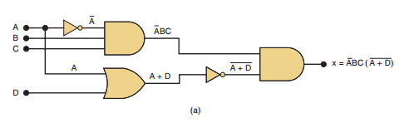
Review Question
Formulate a table for the circuit below to indicate the logic state at each node

Slide 4
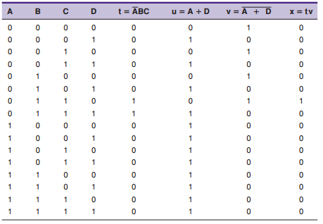
Review Question
Formulate a table for the circuit below to indicate the logic state at each node

Slide 5
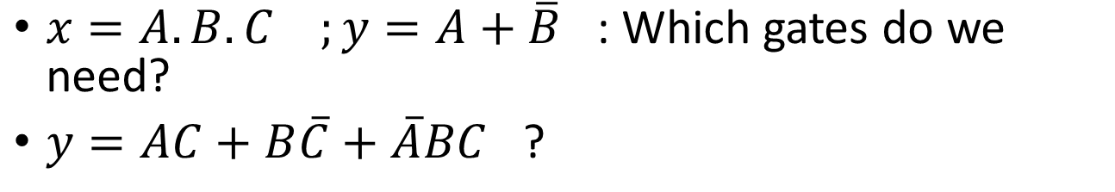
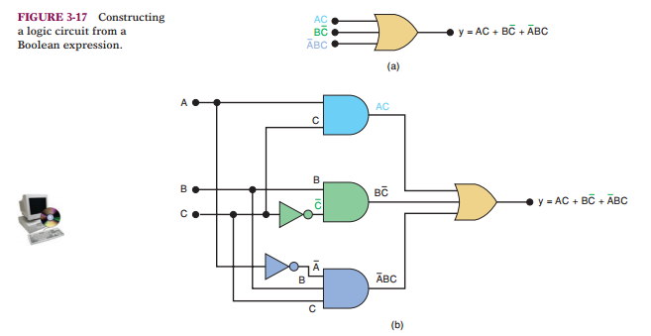
Building circuits from Boolean Expressions
Image source: Tocci and Widmer

Slide 6
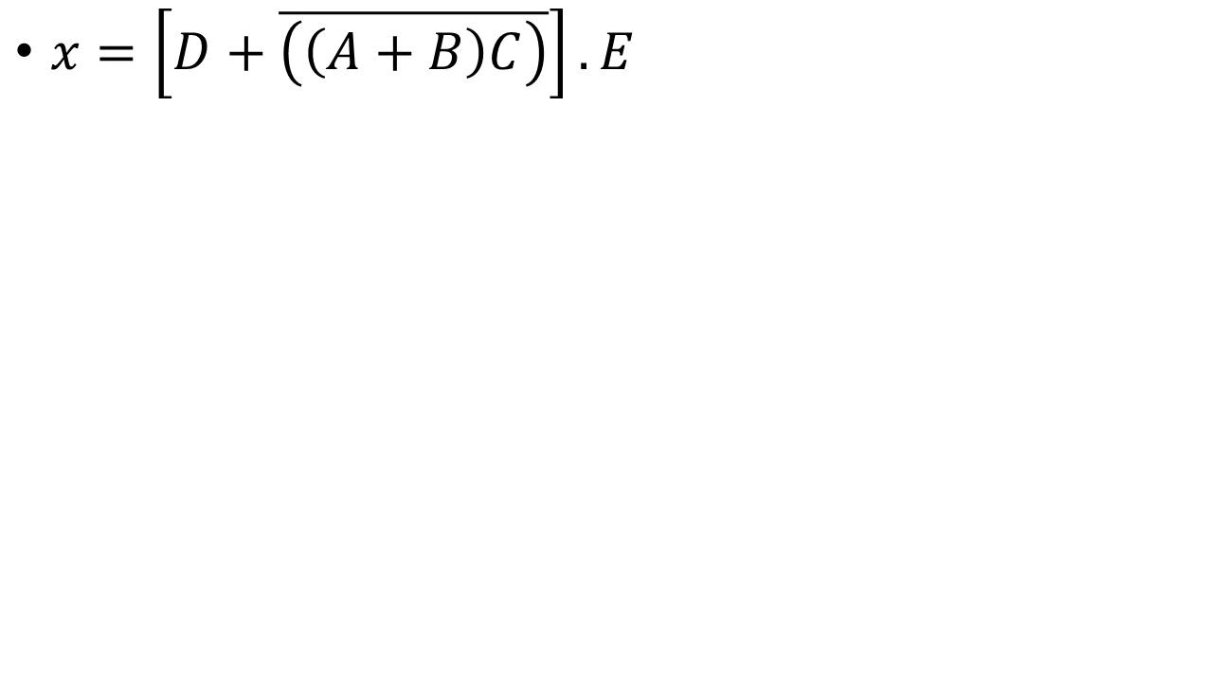
Review Question

Slide 7
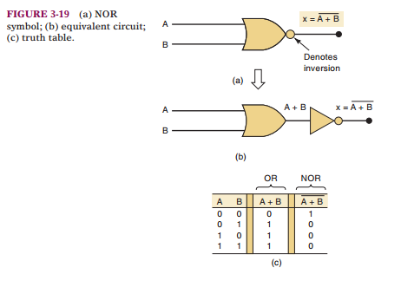
NOR AND NAND GATES
Combination of OR , AND and NOT gates

Slide 8
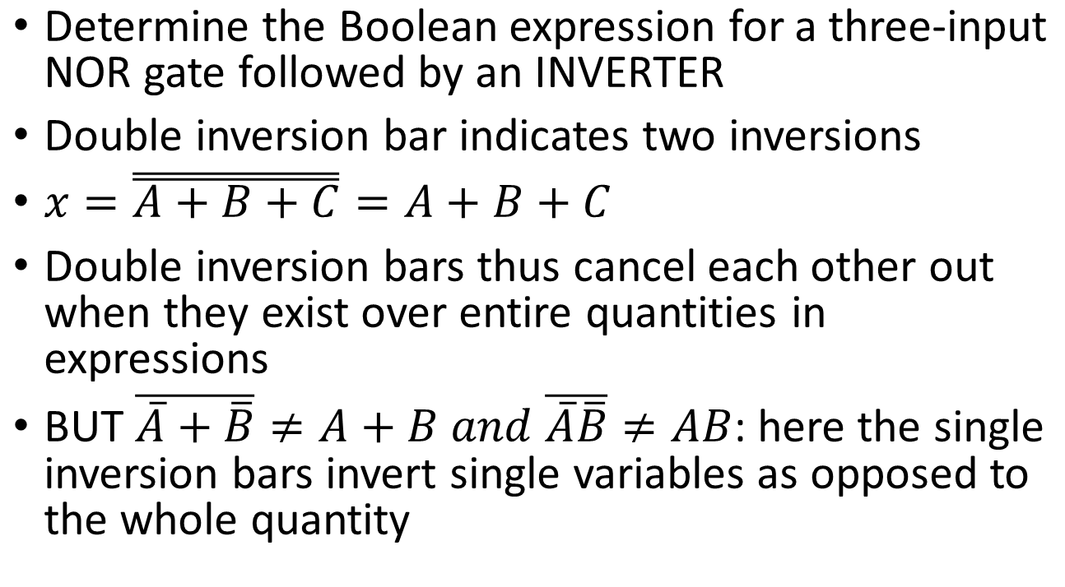
NOR gate

Slide 9
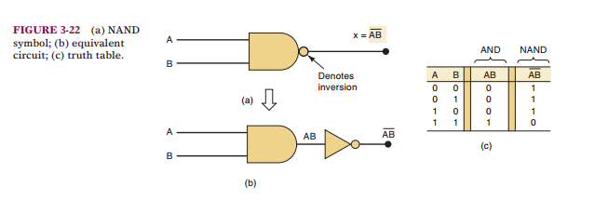
NAND Gate

Slide 10
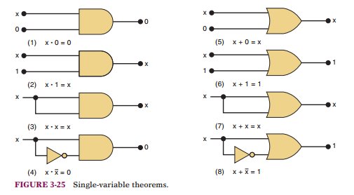
BOOLEAN THEOREMS
Simplify logic expressions and circuits
***x is a logic variable that is either 0 or 1

Slide 11
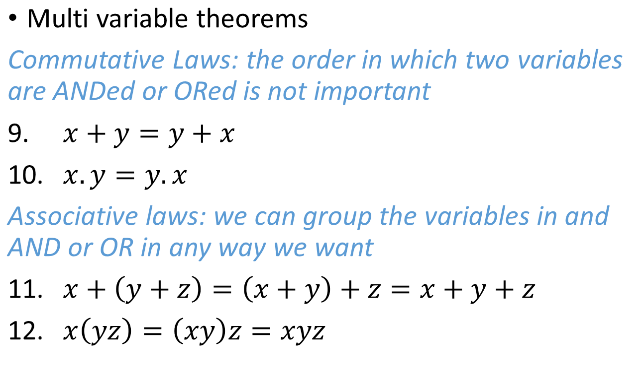
BOOLEAN THEOREMS
***x is a logic variable that is either 0 or 1

Slide 12
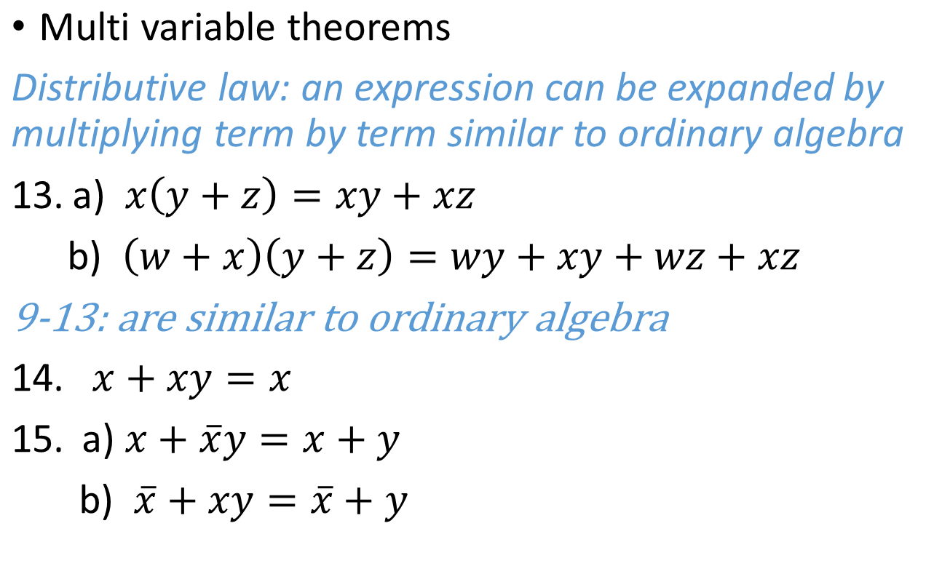
BOOLEAN THEOREMS
14 – 15 can be proved by trying all possible combinations : Do this at home!

Slide 13
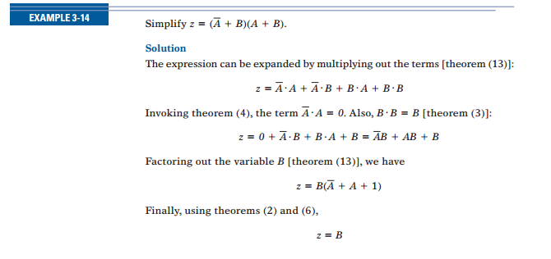
Example

Slide 14
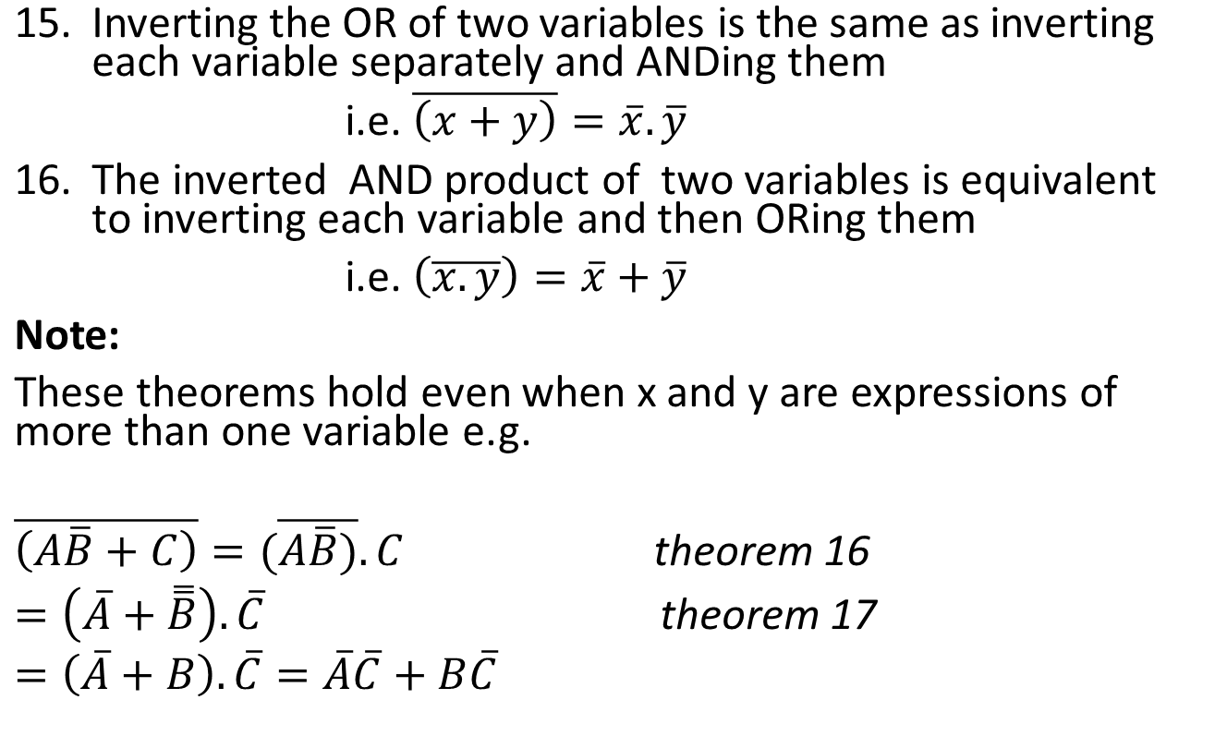
DEMORGAN’S THEOREMS

Slide 15
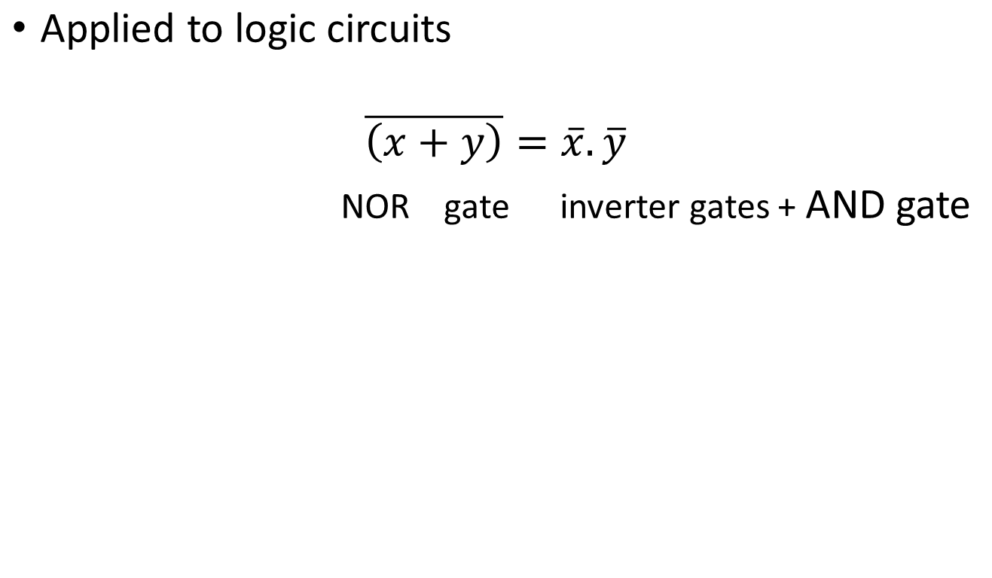
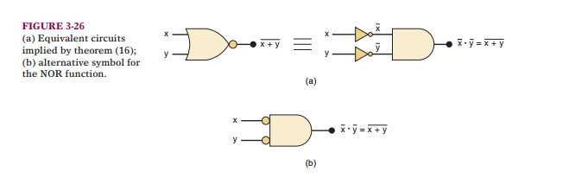
DEMORGAN’S THEOREM

Slide 16
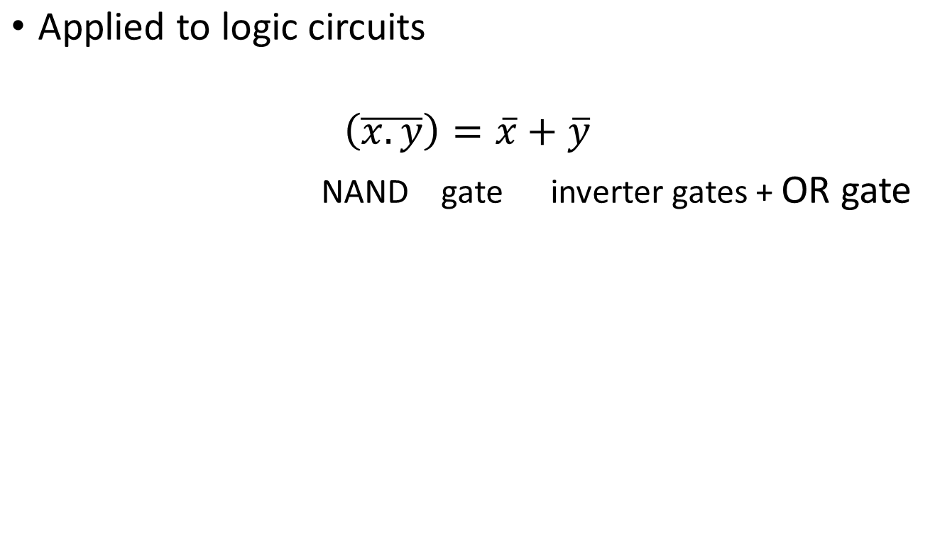
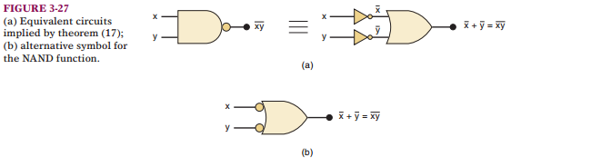
DEMORGAN’S THEOREM

Slide 17
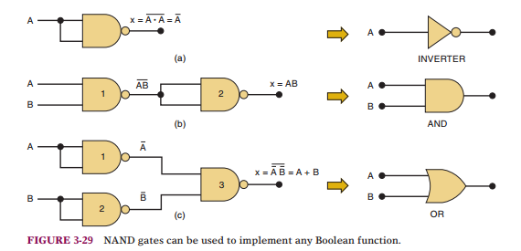
UNIVERSALITY OF NAND AND NOR GATES
All Boolean expressions consist of OR, AND, INVERT
So any circuit can be implemented with AND, OR, NOT gates
We can also use ONLY NAND or ONLY NOR gates → can be combined to do any of the above 3 operations

Slide 18
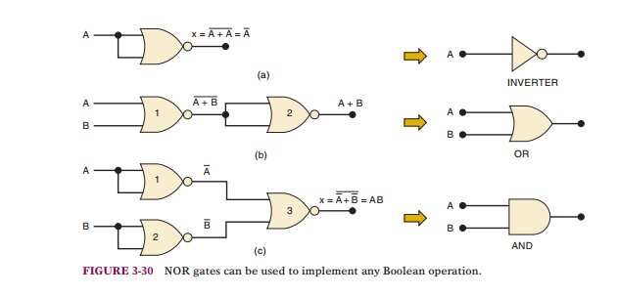
UNIVERSALITY OF NAND AND NOR GATES
Verify Equivalence at home!

Slide 19
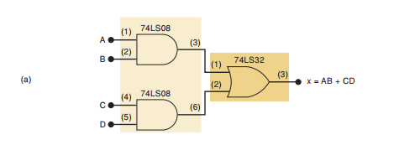
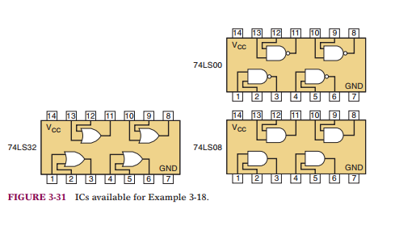
Example
Given Expression x = AB+CD and TTL IC’s below: How can we implement this circuit with minimum number of IC’s.
Solution A : Basic Solution; 2 AND gate and 1 or gate , 2 IC’s

Slide 20
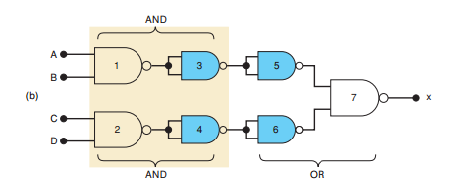
Example
Given Expression x = AB+CD and TTL IC’s below: How can we implement this circuit with minimum number of IC’s.
Solution B : Replace AND and NOT with 7 NAND gates → 1 IC

Slide 21
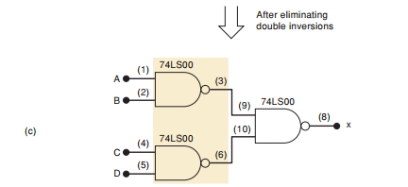
Example
Given Expression x = AB+CD and TTL IC’s below: How can we implement this circuit with minimum number of IC’s.
Solution C : Observe gates 3&5 are connected as inverters in series therefore doing double inversion of output 1 = output one. Can eliminate 3,5, 4,6 →3 gates, 1 IC

Slide 22
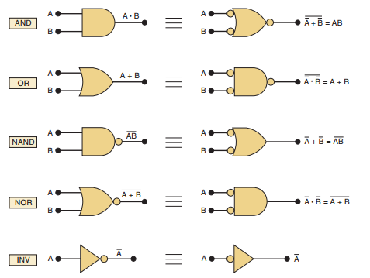
Alternate Logic Gate Representations
Invert each input and output of the standard symbol (add or remove bubbles)
Change AND to OR and vice versa
** It can be applied to gates with any number of inputs

